Slide 1


SUPERMARKET SALES INSIGHT DASHBOARD

Slide 2

SUMMARY
02
Forecast & Geography Insight
This report gives an overview of Sales Forecast for 15 days and Geographic insights
01
03
Sales Insights
Visualization
This report gives an overview about sales data
This report shows flexibility for the end users to toggle between different visualization buttons.

Slide 3

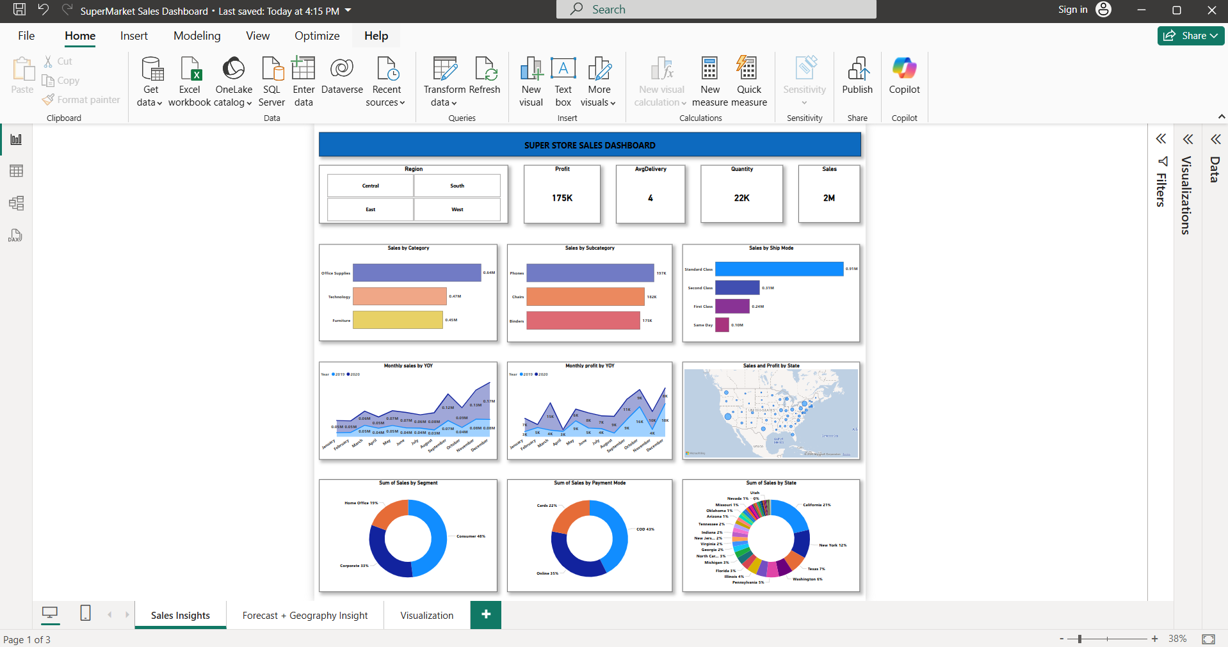
Key Insights
$2M Sales, $175K Profit, 22K Units Sold
Top Sellers: Tech & Office Supplies (Phones & Chairs lead)
Popular Shipping: Standard Class dominates, Same-day lags
Best Markets: California & New York drive sales
Who’s Buying? Consumers (45%), Corporate (33%)
Payments: Online (39%) vs. COD (41%)—room to shift prepaid
Sales Insight Dashboard

Slide 4
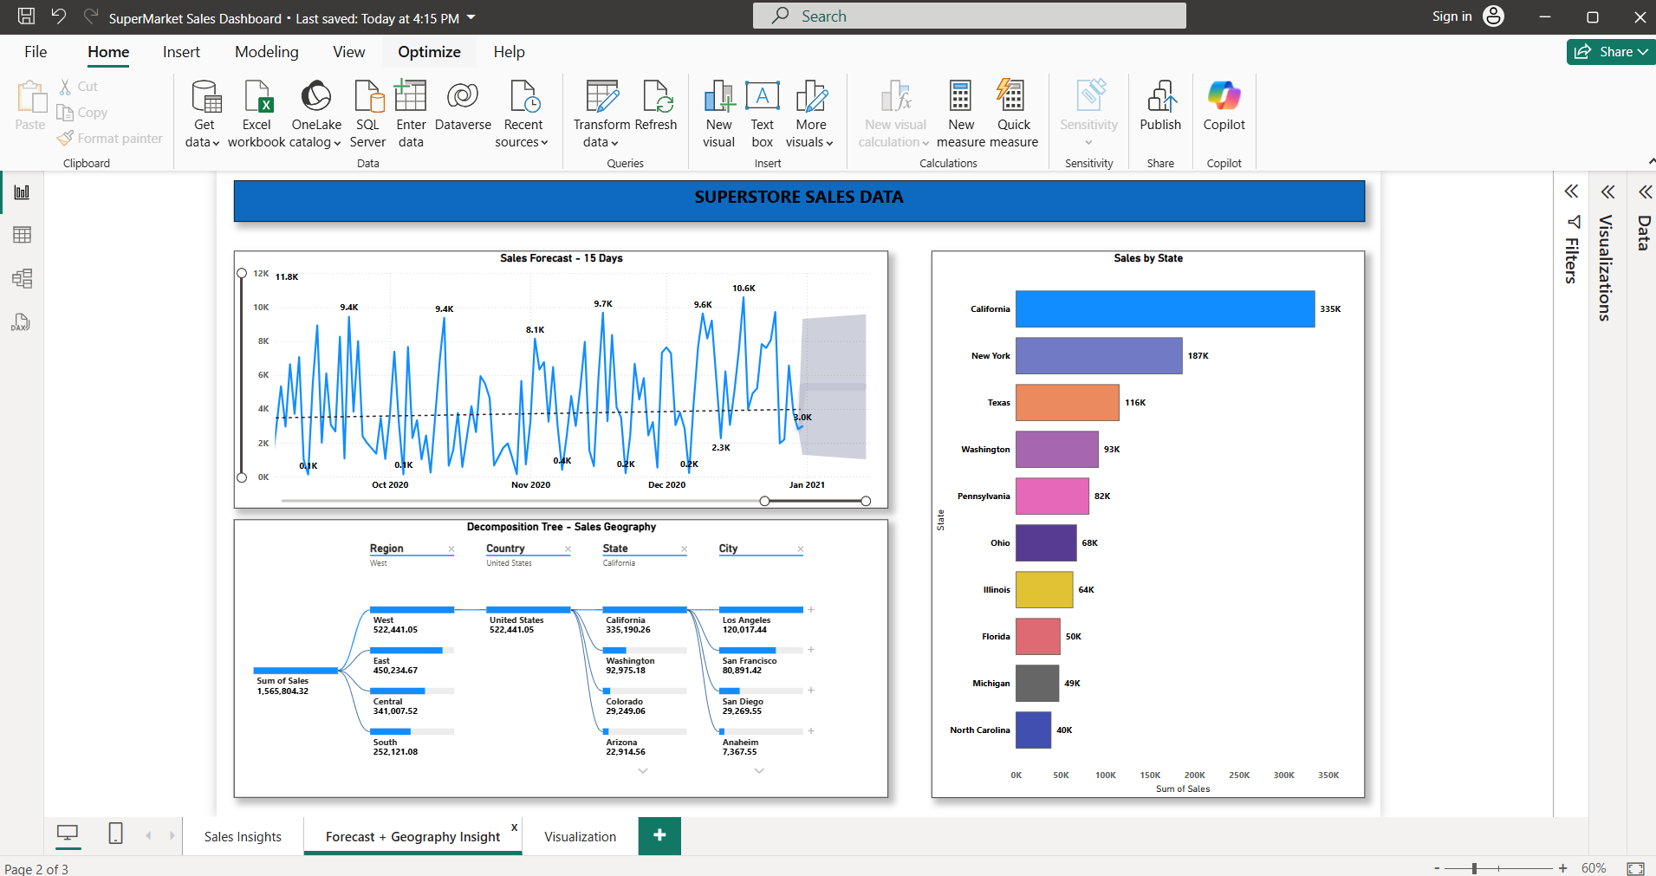
FORECAST & GEOGRAPHY INSIGHTS
Key insights
1. Top State: California leads with 335K sales — more than New York (187K) and Texas (116K) combined.
2. Sales Trend: Peaks hit 11.8K, but the forecasted dip to 3K suggests a slowdown. Action may be needed to prevent the drop.
3. Geography Breakdown: The West region dominates sales (522K), with Los Angeles (120K) and San Francisco (80K) driving California’s success.
FORECAST & GEOGRAPHY INSIGHTS

Slide 5
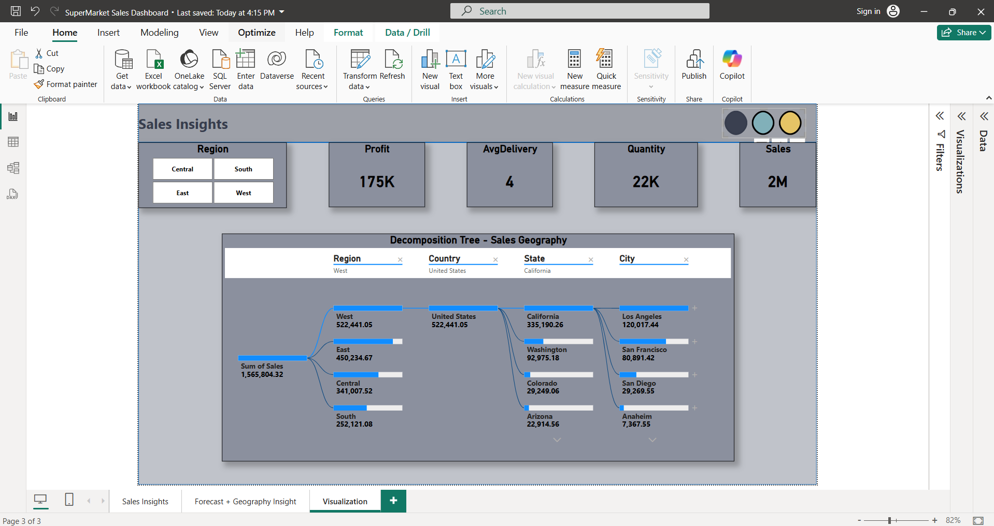
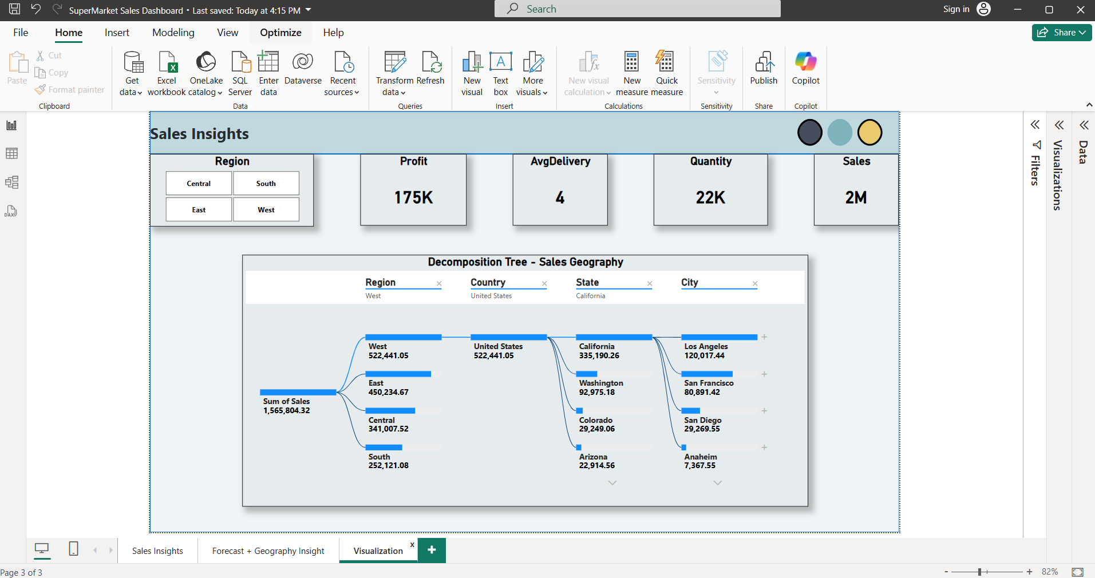
VISUALIZATION
VISUALISATION
Theme Selection Buttons (Top Right):
Three circular buttons (Gary, Green, yellow), switches the dashboard's color scheme.
Clicking on a button changes the background, and visual elements for customization.
Interactive Filters (Region Selection):
The four rectangular buttons (Central, South, East, West) allow users to filter sales insights by region.
Selecting a region updates the decomposition tree and other visuals dynamically.

Slide 6
THANK YOU
Successful Entry
Our analysis indicates a strong likelihood of success in the new market. The market offers growth potential, and the company’s competitive advantages will allow it to thrive.
The detailed implementation roadmap will guide the company through the key milestones of market entry.

